Slide 1

CircuitGuard: Automated PCB Defect Detection & Classification System
A Deep Learning and Computer Vision Approach
Anumula Dinesh Reddy6th December 2025

Slide 2

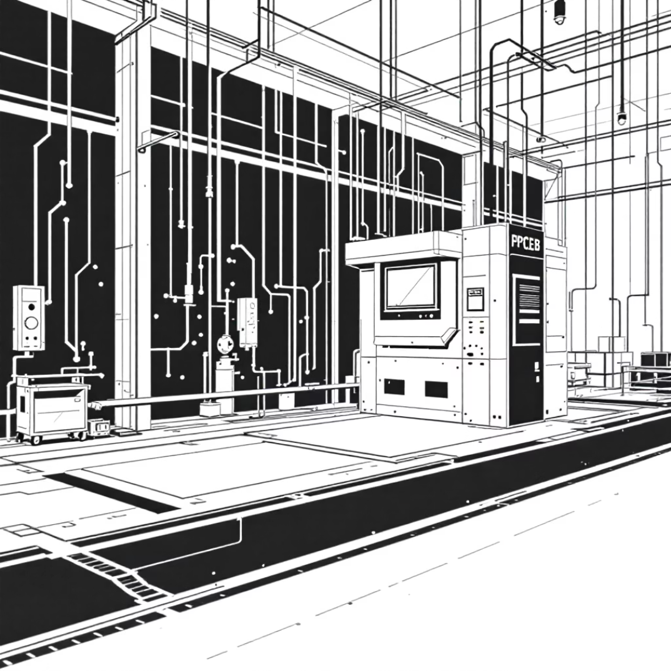

The Challenge: Manual PCB Inspection
The Problem
Our Solution: CircuitGuard
Manual Optical Inspection (AOI) is a bottleneck in high-volume electronics manufacturing. It's not only slow and inconsistent but also highly prone to human error, leading to missed defects and reduced throughput.
We developed an end-to-end automated system using advanced computer vision and deep learning. This system leverages reference-based image subtraction for defect identification and a CNN-based classification pipeline for accurate defect categorization.
Project Goal: Achieve ≥97% classification accuracy on diverse test defects, drastically improving inspection reliability.

Slide 3
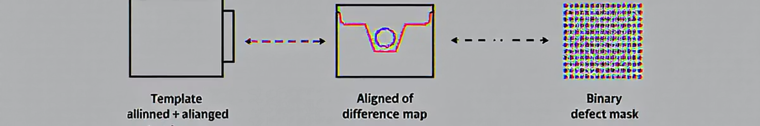



Module 1: Robust Image Localization
The critical first step is precisely aligning images and isolating potential defect areas through intelligent image comparison.
ORB Feature Detection
RANSAC Homography
Image Subtraction & Thresholding
Utilized ORB (Oriented FAST and Rotated BRIEF) feature detection to identify unique, stable keypoints across both the template and test images.
Applied RANSAC (Random Sample Consensus) with cv2.findHomography for robust, sub-pixel image alignment, accurately correcting for shifts and rotations.
Performed Image Subtraction to generate a difference map, followed by Otsu Thresholding (cv2.THRESH_OTSU) to create a clean binary defect mask.

Slide 4
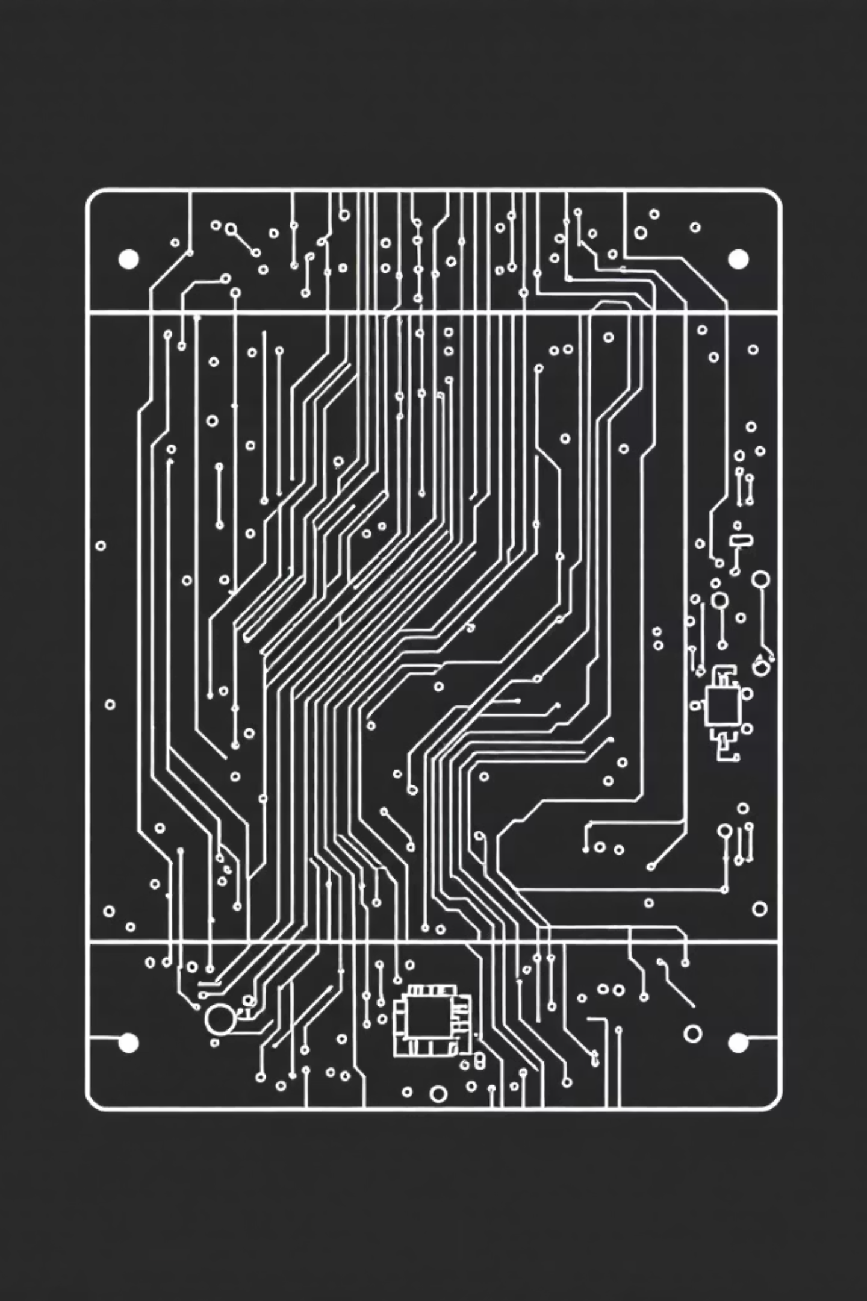


Module 2: ROI Extraction for Training Data
This module focuses on generating a high-quality, labeled dataset of individual defect patches essential for CNN training.
Contour Extraction
Applied cv2.findContours to the binary defect masks (output from Module 1) to precisely delineate the boundaries of each individual defect.
Bounding Box Calculation
Used cv2.boundingRect to calculate tightly fitting bounding boxes around each detected defect contour, isolating the region of interest.
Padded ROI Extraction
Crucially, padding was added to each bounding box before extracting the Region of Interest (ROI) from the original test image. This provides vital contextual information for the classifier.
Labeled Dataset Output
The output is a meticulously prepared, labeled dataset of 128×128 cropped ROI images, ready for deep learning.

Slide 5
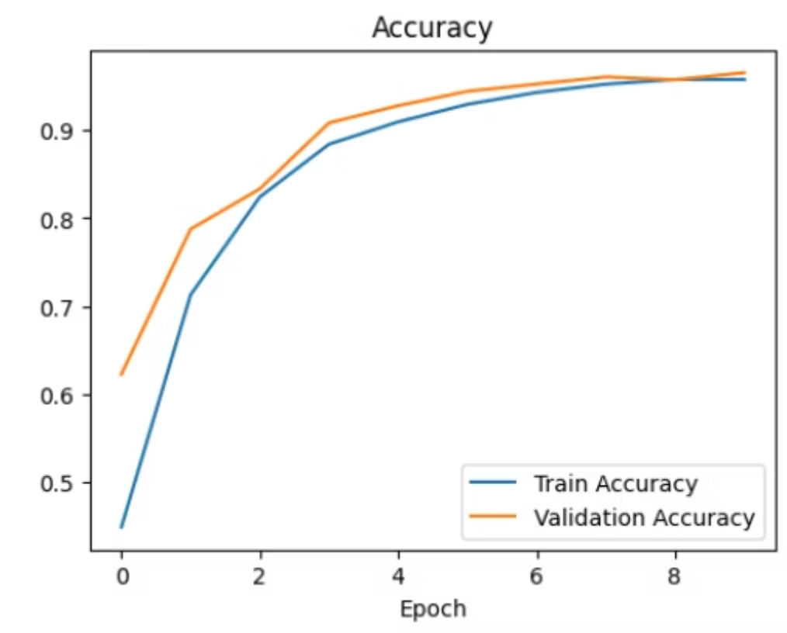



Module 3: EfficientNet Model Training
Implementing and training the robust core classification engine for accurate defect categorization.
Architecture
Training Configuration
Implemented the state-of-the-art EfficientNet-B4 model using PyTorch and the timm library for optimized performance.
Leveraged Transfer Learning with ImageNet pre-trained weights, Adam Optimizer, and Cross-Entropy Loss for rapid convergence.
Data Strategy
Applied extensive data augmentation to the 128×128 ROI images to enhance generalization and prevent overfitting.

Slide 6
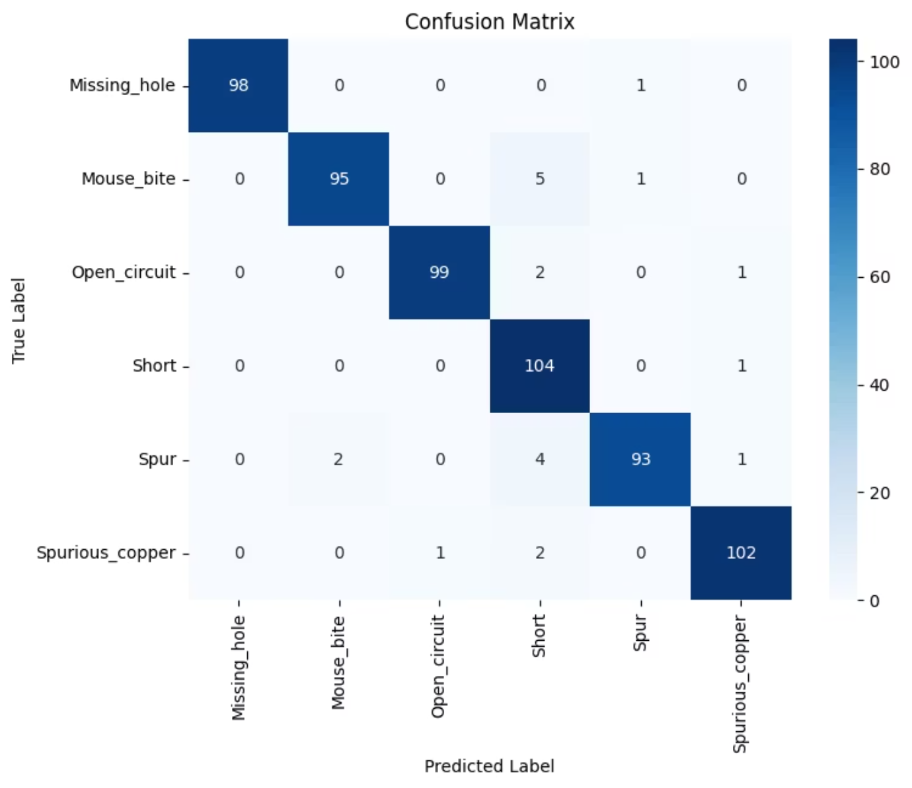
Module 4: Prediction Performance Validation
Rigorous validation of the model's generalization capabilities against unseen defect data.
Key Result: Accuracy
Achieved ≥97.65% Classification Accuracy on the final test set, successfully exceeding the project target.
Evaluation: Reliability
Rigorous testing confirmed a low False Positive/Negative rate, proving the model's reliability across all six defect classes.
Deliverable: Insights
Generated a comprehensive Confusion Matrix and detailed evaluation report, offering transparent performance insights.
The confusion matrix visually confirms the high classification accuracy, with strong diagonal values indicating correct predictions across all defect classes.

Slide 7
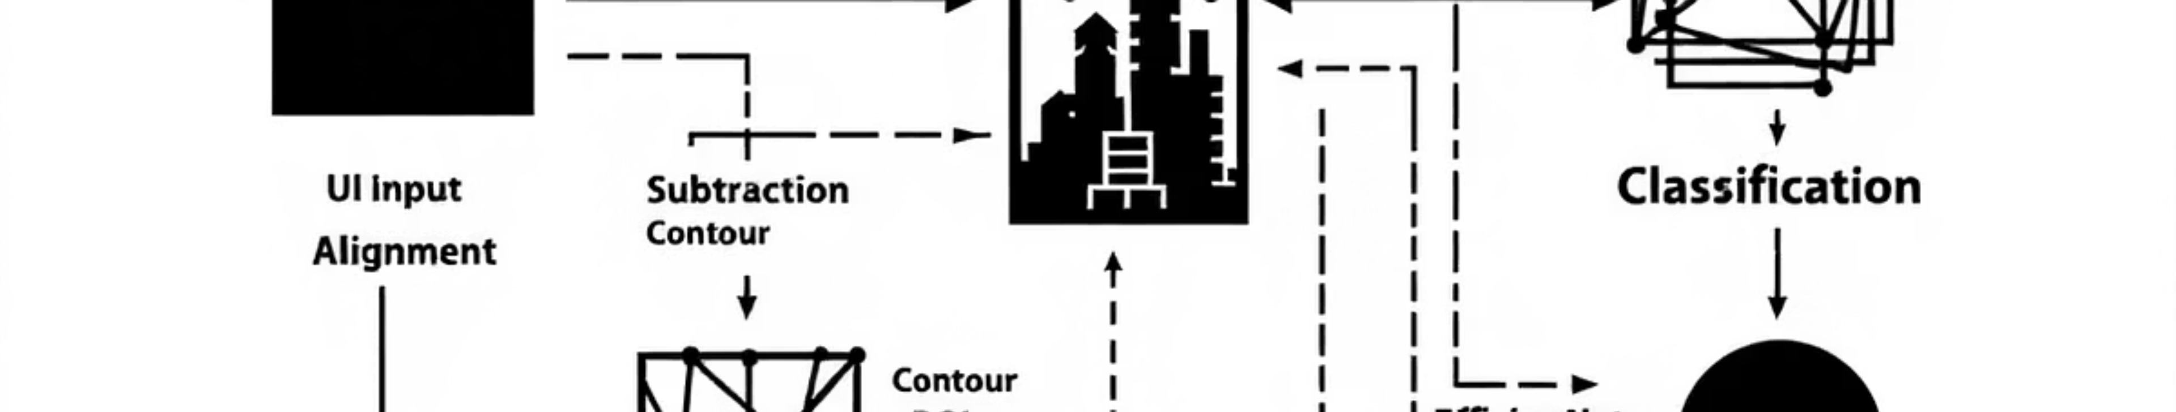
Module 6: Integrated Backend Pipeline
Connecting all developed modules into a seamless, high-performance inference system.
Modular Architecture
Optimized Process Flow
Zero-Latency Optimization
Refactored complex OpenCV (M1/M2) and PyTorch (M4) logic into modular, reusable functions for maintainability and scalability.
The backend executes a full sequence: Alignment → Subtraction → Contour → ROI → EfficientNet Classification → Annotation for end-to-end processing.
The EfficientNet model checkpoint is loaded only once upon startup, eliminating reload delays and ensuring minimal latency for subsequent user requests.

Slide 8
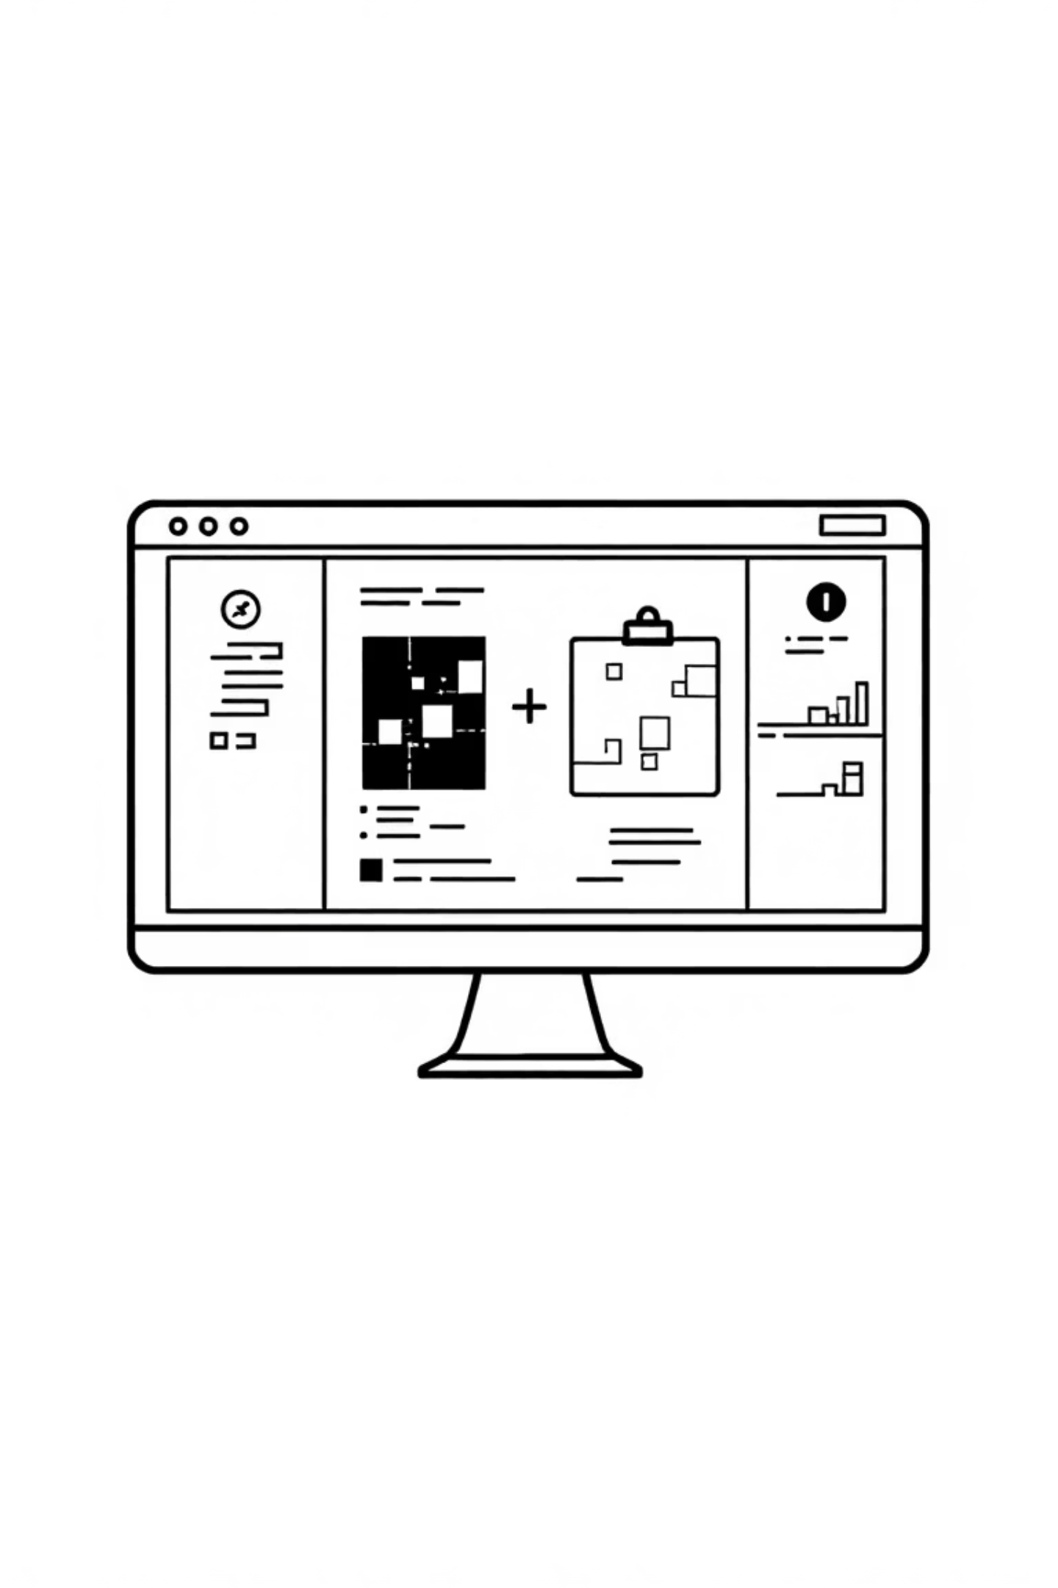



Module 5: The User Interface (UI)
A functional and intuitive web interface designed for seamless user interaction and defect analysis.
Framework
Key Functionality
Developed the frontend using Streamlit for rapid prototyping and deployment, ensuring a dynamic and responsive user experience.
Provides dedicated, simple upload fields for both the Template and Test images, streamlining the defect analysis process.
Output Visualization
Displays the final output image with clear bounding boxes and predicted class labels, offering immediate visual feedback.

Slide 9
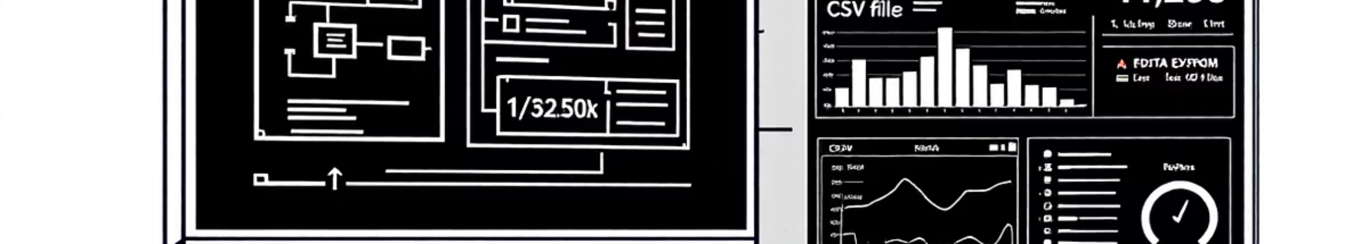
Module 7: Performance & Data Export
CircuitGuard ensures system robustness, speed, and provides essential documentation features for actionable insights, offering rapid defect detection and comprehensive data management.
Performance Optimization
Data Export & Documentation
Achieves ≤5 second upload-to-output time per image.
Download annotated images with bounding boxes and class labels.
Enables real-time defect detection for immediate action.
Export CSV prediction logs with defect details and confidence scores.
Significantly enhances inspection throughput.
Facilitates robust quality control and seamless system integration.

Slide 10
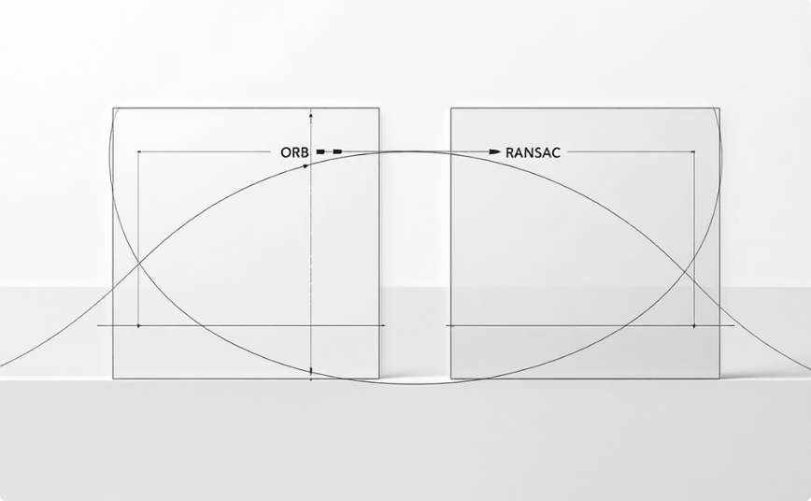

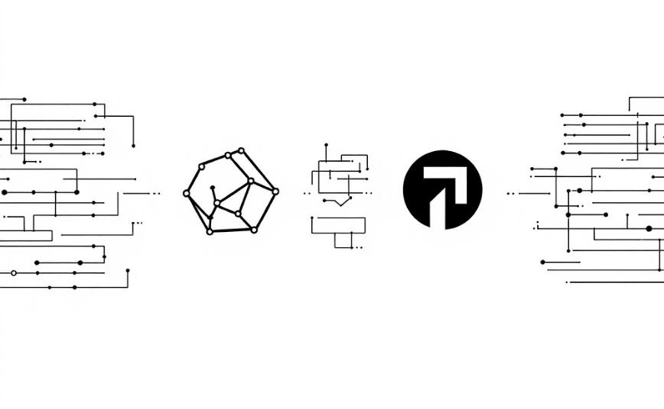

Technical Synthesis: Key Successes
Robust Alignment
Data Quality Focus
Full Integration
Achieved robust initial data synchronization using ORB and RANSAC, a non-trivial but critical step for accurate subtraction and defect identification.
The two-stage process (Localization and Classification) ensured the CNN trained exclusively on high-quality, relevant ROI patches, paramount for reaching ≥97% accuracy.
Successfully integrated complex libraries like OpenCV and PyTorch into a single, functional Python application, showcasing end-to-end system development.
Proficiency Confirmed:
Demonstrated expertise in PyTorch, EfficientNet, OpenCV, and Streamlit for practical, real-world applications.

Slide 11


Challenges & Future Scope
Technical Challenges Overcome
Future Work & Enhancements
Alignment Refinement
Initial struggles with non-linear distortions during image alignment were overcome by extensive fine-tuning of RANSAC parameters, ensuring precise homography estimation for accurate defect detection.
Unified Object Detection
Explore advanced object detection models (e.g., YOLO, Faster R-CNN) to unify defect localization and classification into a single, more efficient pipeline.
Noise Reduction
Excessive noise from initial image subtraction was effectively managed by strategically applying Erosion and Dilation morphological filters, as detailed in Module 1, to produce clean defect masks.
Containerized Deployment
Containerize the application using Docker for standardized, isolated, and portable deployment across diverse environments, simplifying installation and scaling.

Slide 12
Conclusion: CircuitGuard's Success
The CircuitGuard system stands as a professional-quality solution that successfully automates PCB defect inspection, delivering high accuracy and minimal latency for critical manufacturing environments.
Fully Functional Web App
Robust Trained Model
Comprehensive Documentation
A user-friendly Streamlit interface, providing seamless image upload and defect visualization.
An EfficientNet-B4 classification model achieving ≥97.65% accuracy on diverse defect types.
Detailed technical reports, performance metrics, and a CSV export for data analysis.
Thank You
Anumula Dinesh Reddy

